Slide 1

Optimization Algorithms
Adam optimization
algorithm
deeplearning.ai

Slide 2
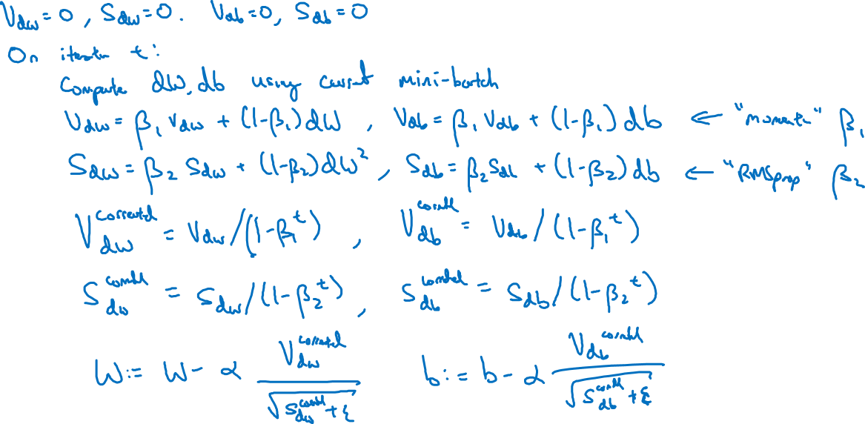
Adam optimization algorithm
yhat = np.array([.9, 0.2, 0.1, .4, .9])

Slide 3

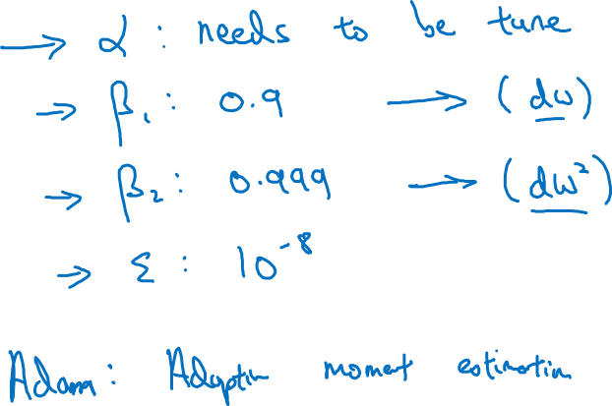
Hyperparameters choice:
Adam Coates

